Slide 1
Cs-381 Software Engineering
Course Instructor: Dr. Shazia Arshad
Notes:
Welcome to all of you in this course. I am Dr. Shazia Arshad. I will be your instructor for this course.

Slide 2
Data Flow Diagram
A Data Flow Diagram (DFD) is a traditional visual representation of the information flows within a system.
A neat and clear DFD can depict a good amount of the system requirements graphically.
It is a representation of flow of data or information into or out of a system.
It is a picture of the movement of data between external entities, processes and data store within a system.

Slide 3
ELEMENTS OF DFD
External Entity: People or organisations that send or receive data from system.
Process: Method to transform input into output.
Data Store: Storage of data.
Data Flow: Shows flow of data between different elements.

Slide 4
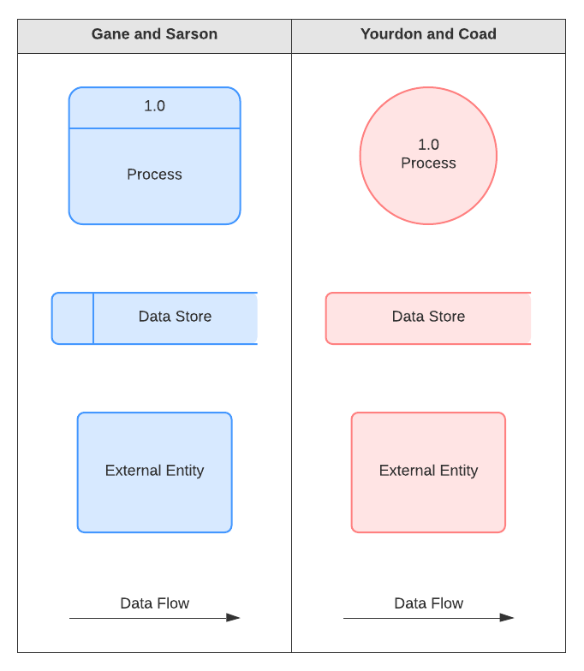
Notations used

Slide 5
Levels of DFD
There exists 3 different levels of DFD's.
Level 0 (Context Diagram)
Level 1 (Overview Diagram)
Level 2 (Detailed Diagram)
Each level provides details of the previous level.

Slide 6
Level 0 (Context Diagram)
Shows complete system as a single process.
Input and output data is denoted by incoming and outgoing arrow.
Goal is to identify external entities involved in system.
The context diagram must fit in one page.
The process name in the context diagram should be the name of the system.
All external entities are shown on the context diagram as well as major data flow to and from them.
The diagram does not contain any data storage.

Slide 7
Level 1 (OVERVIEW Diagram)
Gives overview of full system.
Goal is to identify major processes involved in the system and data flow between processes.
Identify data storage for different processes.
Add basic functionality of each process.
Draw input and output of different processes.

Slide 8
Level 2 (Detailed Diagram)
Gives detailed description of full system.
Each process from level 1 is decomposed to show its major components.
Add all the functionality related to a process.

Slide 9
Naming Convention
On level 1, processes are numbered 1,2,3...
On level 2, the corresponding processes are numbered x.1, x.2, x.3..... where x is the number of parent process in level 1.
Data Store numbers are usually D1, D2, D3...
Process Labels should be descriptive, clearly state what the process does e.g. Login Process.
Data Store Label should describe the data stored.
Labels should be meaningful.

Slide 10
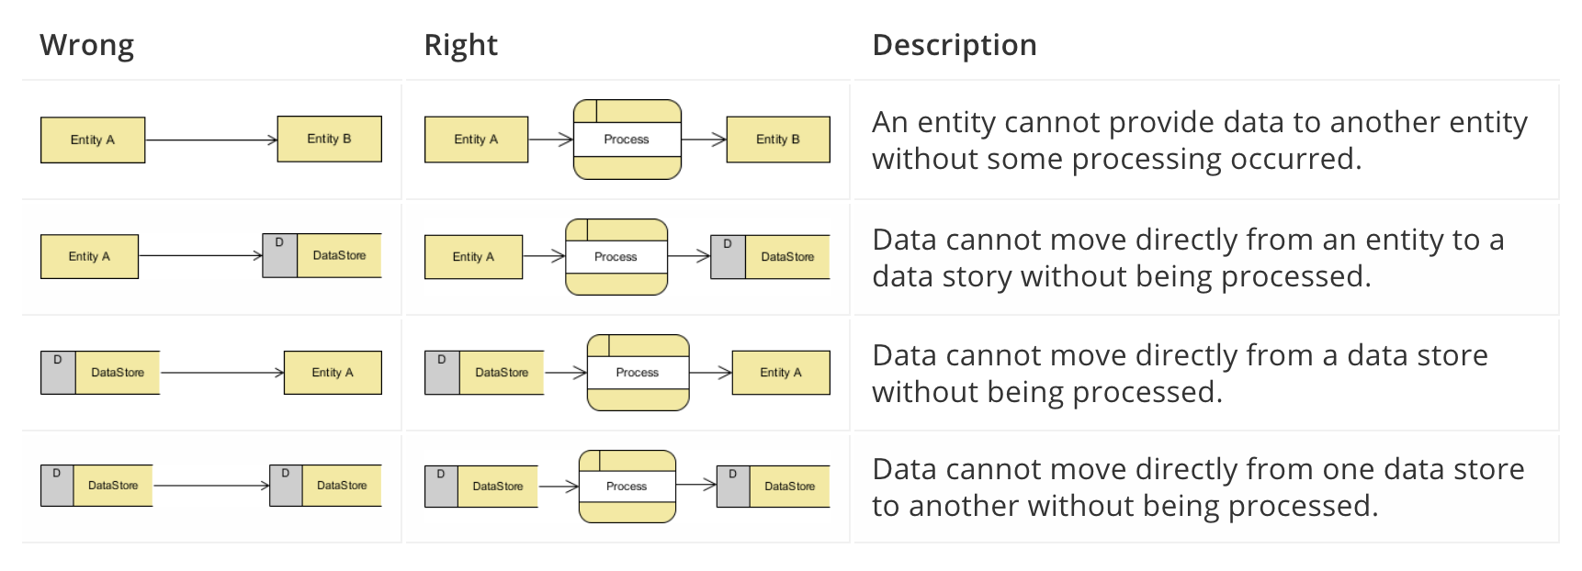
Rules
Data Flow entering or leaving a parent level must be equivalent to those on child level.

Slide 11

TIME TO THINK
Draw Data Flow Diagram for your project????

